Slide 1
Video coding and Compression Part II
B C Dhara
Department of Information Technology
Jadavpur University

Slide 2
Types of frames
So far, we discuss two types of frames:
  I-frame (intra-frame), independent coding like JPEG
  P-frame (inter-frame), i) estimate the frame using motion search, ii) consider the difference frame respect to the reference frame and then iii) encode the difference frame by JPEG like method.
B C Dhara, Dept. of IT, JU

Slide 3
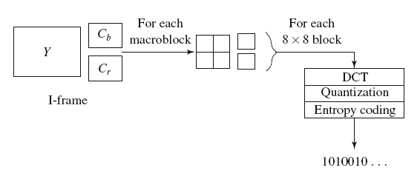
I-frame coding
4:2:0 sampling
F-frame → F’-frame
B C Dhara, Dept. of IT, JU

Slide 4
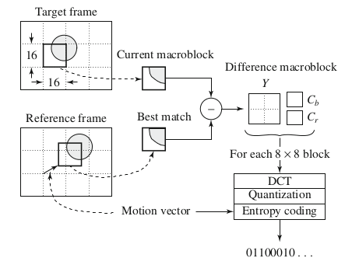

P-frame coding
Prediction from previous known as forward prediction
F-frame → F’-frame
P frames induce a sequential forward dependency during coding
B C Dhara, Dept. of IT, JU

Slide 5
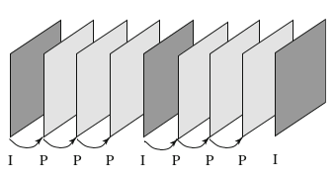
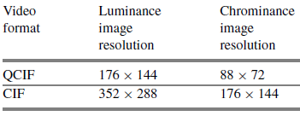
P-frame coding (contd ...)
.
.
.
.
.
.
.
.
.
.
.
.
F₁
F₂
F₃
F₄
error
error
error
I₁
P₂
P₃
P₄
when to stop predicting using P frames, and insert an I frame
B C Dhara, Dept. of IT, JU
video format supported by H.261

Slide 6
Open loop motion compensation
In motion compensation, current frame n+1 is predicted from the reference frame n (original version of the frame n is available to the encoder
At the receiver end, a version of n+1 will be computed and at that time reconstructed version of reference frame n will be available (not the original frame n)
  Due to this error frame will be reconstructed
  This error will be cumulated in successive frames …
B C Dhara, Dept. of IT, JU

Slide 7
Closed loop motion compensation
Attempts to predict frame n+1not from the input reference frame n
  but from a quantized and decoded version of frame n
The encoder in this case also simulates a decoder, which it uses to decode and reconstruct the reference frames to use in motion compensation
This prevents the error from accumulating
B C Dhara, Dept. of IT, JU

Slide 8
Quantization control
Intra-coding
Current
frame
Variable length
coding
F₁’
DCT
Q
Q⁻¹
IDCT
Frame memory
F₁’

Slide 9
Quantization control
Current
frame
Q
Variable length
coding
F₂’
DCT
Q⁻¹
Difference frame
Inter-coding
IDCT
Motion compensation
Frame memory
F₂’
F₁’
F₂
Motion estimation

Slide 10
Quantization control
Intra-coding
Current
frame
Variable length
coding
F₁’
DCT
Q
Inter-coding
Q⁻¹
Difference frame
IDCT
Motion compensation
Frame memory
Motion estimation

Slide 11
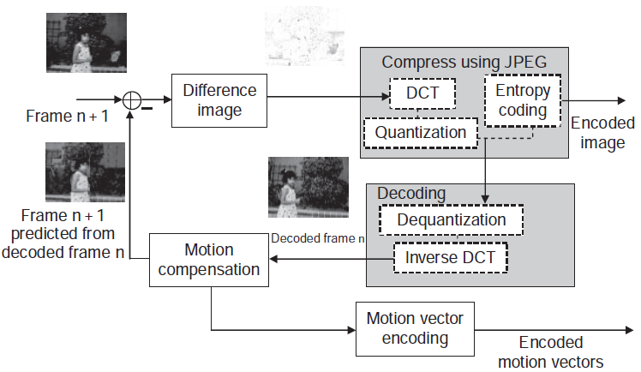
Closed loop motion compensation
B C Dhara, Dept. of IT, JU

Slide 12

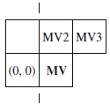
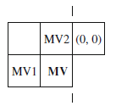
Motion estimation in predicive mode
The motion vector (MV) is, however, not simply derived from the current macroblock
up = median(u1, u2, u3)
vp = median(v1, v2, v3)
MB₁₁
MB₁₂
MB_{1n}
For MB₁₁, there is no prediction
For other mcroblocks, MV of the previous block is the predicted one
MB₂₁
MB₂₂
MB_{2n}
MB_{m1}
MB_{m2}
MB_{mn}
B C Dhara, Dept. of IT, JU

Slide 13
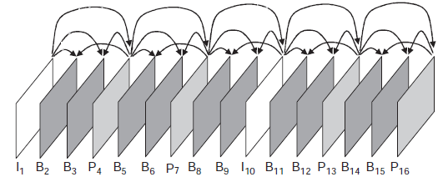
B-frame
Bidirectionally coded ` frames:
  Inter coded and exploit temporal redundancy
  Uses two reference frames (unlike one frame in P-frame)
To predict B frame, the previous (past) and next (future) frames are used
  Sometimes, a macroblock of the current frame has best match with the past frame
  Increases correctness in prediction
  The past and future frames will be either I or P (not B)
  From B-frame no one can be predicted
B C Dhara, Dept. of IT, JU

Slide 14
B-frame
For each macroblock of a B-frame will specify up to two motion vectors, one from the forward and one from the backward prediction
If matching in both directions is successful,
  two motion vectors will be sent, and the two corresponding matching macroblocks are averaged ( “%” denotes) before comparing to the target macroblock for generating the prediction error
If an acceptable match can be found in only one of the reference frames
  only one motion vector and corresponding macroblock will be used from either the forward or backward prediction
B C Dhara, Dept. of IT, JU

Slide 15
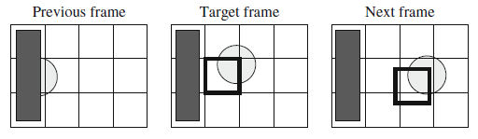
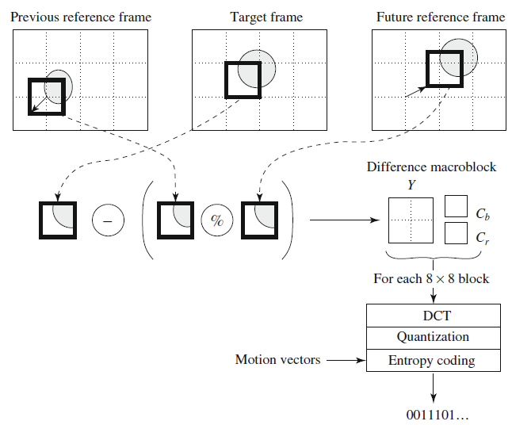
Compensation in B-frame
B C Dhara, Dept. of IT, JU

Slide 16

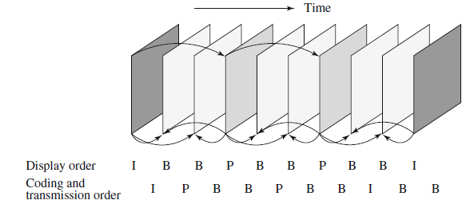
B-frame prediction
Encoding order
1
3
4
2
6
7
5
9
10
8
B C Dhara, Dept. of IT, JU

Slide 17
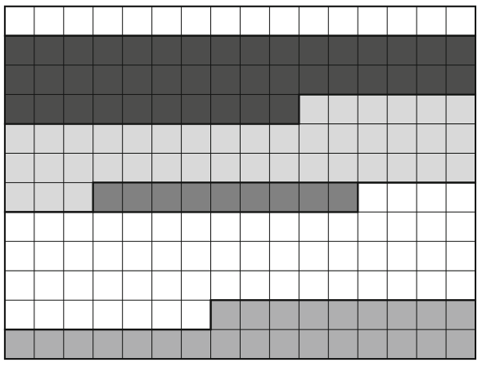
MPEG-1 divides the frame into one or more slices
Variable number of macroblocks in a slice
May start and end anywhere
Each slice coded independently, flexibility in bitsream
GOBs
B C Dhara, Dept. of IT, JU

Slide 18
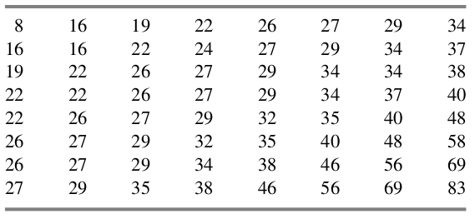
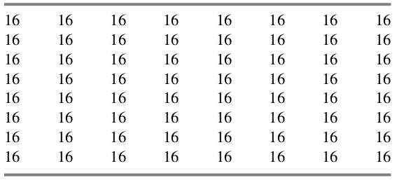
Default quantization table for
intracoding
Default quantization table for
intercoding
B C Dhara, Dept. of IT, JU

Slide 19
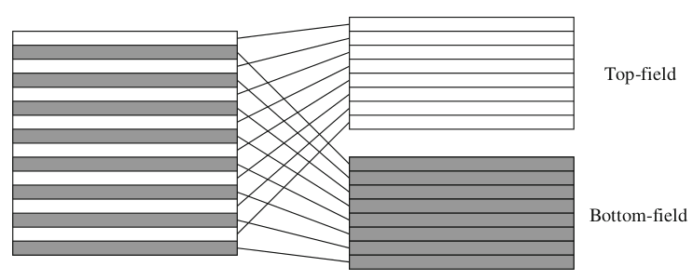
Interlaced video
In interlaced video each frame consists of two fields, referred to as the top-field and the bottom-field
In a frame-picture, all scanlines from both fields are interleaved to form a single frame
  Divided into 16 × 16 macroblocks and coded using MC
Frame picture
Field pictures
B C Dhara, Dept. of IT, JU

Slide 20
Five Modes of Predictions
In MC, there are frame prediction and field prediction as well as five different prediction modes, suitable for a wide range of applications where the requirement for the accuracy and speed of motion compensation vary
Frame prediction for frame-pictures: This is identical to MPEG-1 motion compensation-based prediction methods in both P-frames and B-frames
  Frame prediction works well for videos containing only slow and moderate object and camera motions
B C Dhara, Dept. of IT, JU

Slide 21
Field prediction for field pictures:
Top field
Top field
Bottom field
Bottom field
i: I or P
B C Dhara, Dept. of IT, JU
i+1: P

Slide 22
Field prediction for field pictures:
Top field
Top field
Top field
Bottom field
Bottom field
Bottom field
i: I or P
B C Dhara, Dept. of IT, JU
i+1: B
i+2: P

Slide 23
Field prediction for frame-pictures:
A macroblock of the Current P-frame
Top filed and bottom field of previous I/P is used
Top field 8x16
Two motion vectors are generated for a 16x16 marcoblock
Macroblock 16x16
The bottom field be predicted
from either field from the preceding I/P-frame
Bottom field 8x16
Four motion vectors are generated for each 16x16 marcoblock of B-frame
B C Dhara, Dept. of IT, JU

Slide 24
16 × 8 MC for field pictures
A macroblock of the Current P-frame
8x16: first 8 rows
Two motion vectors are generated for a 16x16 marcoblock
Macroblock 16x16
This mode is good for finer motion compensation when motion is rapid
and irregular.
8x16: last 8 rows
Four motion vectors are generated for each 16x16 marcoblock of B-frame
B C Dhara, Dept. of IT, JU

Slide 25
H.264 video standard
The Joint Video Team (JVT) of ISO/IEC MPEG and ITU-T VCEG (Video Coding Experts Group) developed the H.264 video compression standard
It was formerly known by its working title “H.26L.”
The final draft of the first version of H.264 was completed in May 2003
H.264 is also known as MPEG-4 Part 10, AVC (Advanced Video Coding)
It is often referred to as the H.264/AVC (or H.264/MPEG-4 AVC) video coding standard
B C Dhara, Dept. of IT, JU

Slide 26
H.264/AVC provides a higher video coding efficiency,
  up to 50 % better compression than MPEG-2 and
  up to 30 % better than H.263+ and MPEG-4 Advanced Simple Profile,
  while maintaining the same quality of the compressed video
It covers a broad range of applications, from high bitrate to very low bitrate
B C Dhara, Dept. of IT, JU

Slide 27
It has become the default standard for various applications, e.g., the Blu-ray discs, HDTV broadcasts, streaming video on the Internet, web software such as Flash and Silverlight, and apps on mobile and portable devices
Similar to previous video compression standards, H.264 specifies a block-based, hybrid coding scheme that supports motion compensation and transform coding
B C Dhara, Dept. of IT, JU

Slide 28
Again, each picture can be separated into macroblocks (16×16 blocks), and arbitrary sized slices can group multiple macroblocks into self-contained units
B C Dhara, Dept. of IT, JU

Slide 29
Features of H.264/AVC
Integer transform in 4 × 4 blocks. Low complexity
Variable block-size motion compensation, from 16 × 16 to 4 × 4 in luma images
Quarter-pixel accuracy in motion vectors, accomplished by interpolations
Multiple reference picture motion compensation
  More than just P or B frames for motion estimation
Directional spatial prediction for intra frames
B C Dhara, Dept. of IT, JU

Slide 30
Features of H.264/AVC (contd …)
In-loop deblocking filtering
Context-Adaptive Variable Length Coding (CAVLC) and Context-Adaptive Binary Arithmetic Coding (CABAC)
More robust to data errors and data losses, more flexible in synchronization and switching of video streams produced by different decoders
B C Dhara, Dept. of IT, JU

Slide 31
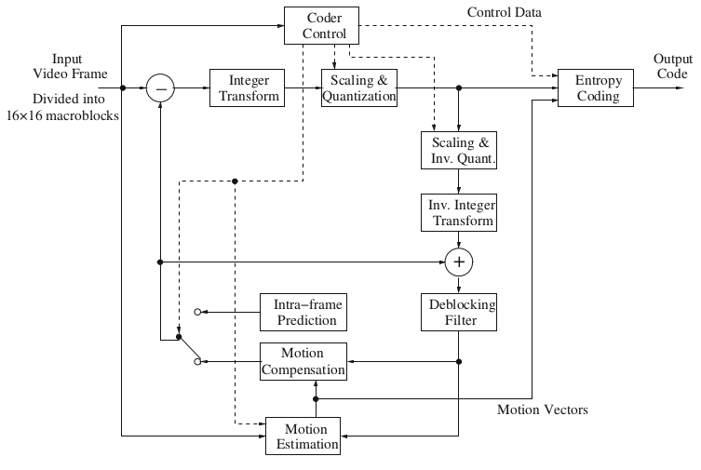
Again, each picture can be separated into macroblocks (16×16 blocks), and arbitrary sized slices can group multiple macroblocks into self-contained units
Basic encoder for H.264/AVC
B C Dhara, Dept. of IT, JU

Slide 32
Decoder of H.264
The decoder has the following five major blocks:
  Entropy decoding
  Inverse quantization and transform of residual pixels
  Motion compensation or intra-prediction
  Reconstruction
  In-loop deblocking filter on reconstructed pixels.
B C Dhara, Dept. of IT, JU

Slide 33
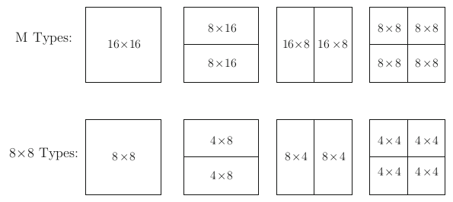
Motion Compensation in H.264
H.264 employs the technology of hybrid coding, i.e.,
  a combination of inter-picture motion predictions and intra-picture spatial prediction,
  and transform coding on residual errors
B C Dhara, Dept. of IT, JU
Segmentation of the macroblock for motion estimation in H.264

Slide 34
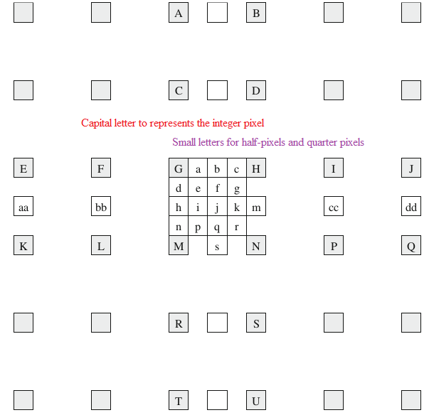
Quarter-Pixel Precision
The process to find the
half-pixel and quarter-pixel
positions from integer pixels
by interpolation
b₁ = E − 5F + 20G + 20H − 5I + J
h₁ = A − 5C + 20G + 20M − 5R + T
b = (b₁ + 16) >> 5
h = (h₁ + 16) >> 5
j₁ = aa₁ − 5bb₁ + 20h₁ + 20m₁ − 5cc₁ + dd₁,
[aa₁, bb₁, ... calculated similar as h₁]
j = ( j₁ + 512) >> 10
a = (G + b + 1) >> 1
e = ( b + h + 1) >> 1
B C Dhara, Dept. of IT, JU

Slide 35
In MPEG, GOPs (group of pictures) starts and ends with I frame
  In between P/B frames
  I/P frame used as reference frame
  Macroblock is predicted by forward reference (P-frame) or forward and backward prediction (B-frame)
H.264 follows this structure along with some additional supports
B C Dhara, Dept. of IT, JU

Slide 36
No B-frames
The prediction of macroblocks in B-frames incurs more delay and requires more storage for the necessary I- and P-frames because of the bidirectional prediction
In this option, only I- and P-frames are allowed
  Although the compression efficiency is relatively low, it is more suitable for certain applications, e.g., videoconferencing where minimal delay is more desirable
  This is compatible with the goals of the Baseline Profile or Constrained Baseline Profile of H.264
B C Dhara, Dept. of IT, JU

Slide 37
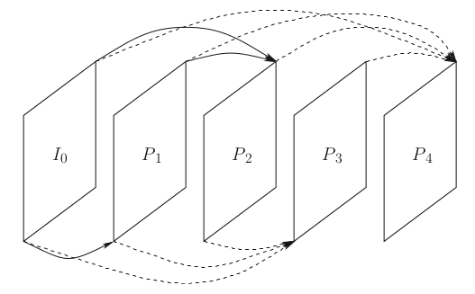
Multiple reference frames
In order to find the best match for each macroblock in P-frames, H.264 allows up to N reference frames
  While this improves the compression efficiency, it requires much more computation in motion estimation at the encoder
  Moreover, it requires a larger buffer to store up to N frames at the encoder and decoder.
B C Dhara, Dept. of IT, JU
Multireference frame, N=4

Slide 38
Hierarchical prediction structure
Hierarchical prediction of H.264 allows flexible prediction
I₀, B₁, B₂, B₃, B₄, B₅, B₆, B₇, B₈, B₉, B₁₀, B₁₁, I₁₂
I₀
I₁₂
B₆
B₃
B₉
B₁
B₂
B₄
B₅
B₇
B₈
B₁₀
B₁₁
B C Dhara, Dept. of IT, JU

Slide 39
Integer Transform
H.264 employs Transform coding after difference macroblocks are obtained
One of the most important features in H.264/AVC is the use of an Integer Transform
The Discrete Cosine Transform (DCT) in previous video coding standards causes prediction shift because of floating point calculation and rounding errors in the transform and inverse transform
It is also slow due to floating point multiplications
B C Dhara, Dept. of IT, JU

Slide 40
History of video coding standards
ITU-T Video Coding Experts Group (VCEG)
  H.261 (1990) → H.263 (1995) → H.263+ (1998) → H.26L
ISO Motion Picture Experts Group (MPEG)
  MPEG1 (1991) → MPEG2 (1994) → MPEG4 (1999)
Joint Video Team (JVT) (VCEG/MPEG) 2001
  H.264/MPEG4 part 10 official title : Advanced video Coding (AVC)
  International standard: December 2002

Slide 41
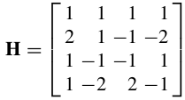
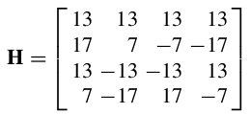
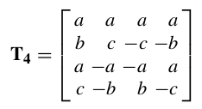

All its rows are orthogonal;
No longer have same norm
All its rows are orthogonal;
They also have the same norm
The 4 × 4 transforms in H.264 approximate the DCT and IDCT
To derive a scaled 4 × 4 integer transform that approximates T₄ , we can simply scale the entries of T₄ up and round them to nearest integers
  H = round(α · T₄ )
Normalization is important
In the H.264 implementation, this is postponed
α=26
α=2.5
It is merged into the quantization process in the next step, since we can simply adjust the values in the quantization matrix to achieve both the objectives of quantization and normalization
B C Dhara, Dept. of IT, JU

Slide 42
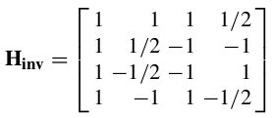
Since H is orthogonal
  H⁻¹ can be approximated with H^{T} and with appropriate scaling
  Scaling factor will be taken care at the time of de-quantization
  An ad-hoc inverse transform is
B C Dhara, Dept. of IT, JU

Slide 43
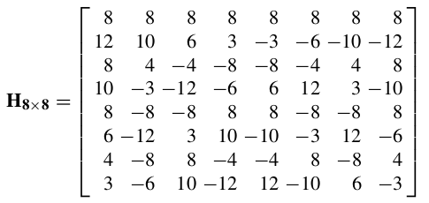
B C Dhara, Dept. of IT, JU

Slide 44
Quantization and Scaling
H.264 has a design which accomplishes both tasks
  the quantization and
  scaling (normalization) of H
B C Dhara, Dept. of IT, JU

Slide 45
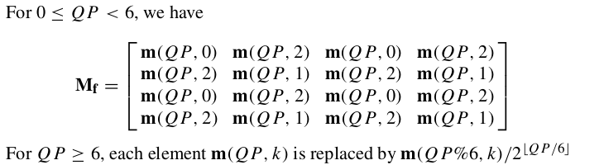

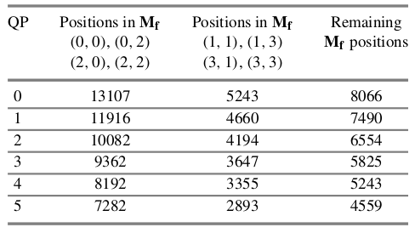

Integer Transform and Quantization
Let f be the 4 × 4 input matrix, and the transformed and then quantized output
The forward integer transform, scaling and quantization are implemented as
‘×’ denotes matrix multiplication, while ‘·’ denotes element-by-element multiplication; M_{f} is the 4 × 4 quantization matrix
QP=2
10082 | 10082 | 10082 | 10082
10082 | 6554 | 10082 | 6554
10082 | 10082 | 10082 | 10082
10082 | 6554 | 10082 | 6554
The quantization is followed by another scaling step, which can be implemented by a right-shift “>>15”
B C Dhara, Dept. of IT, JU

Slide 46
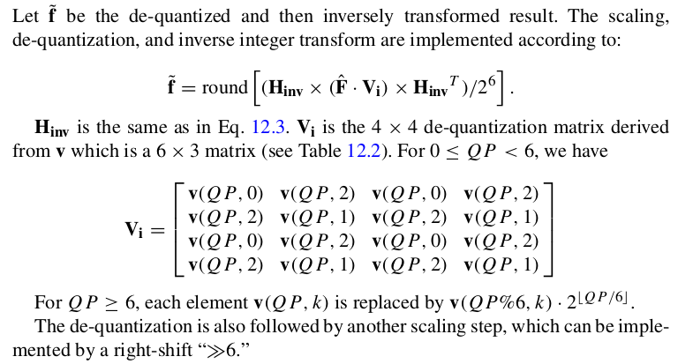
Inverse Integer Transform and De-quantization
B C Dhara, Dept. of IT, JU

Slide 47
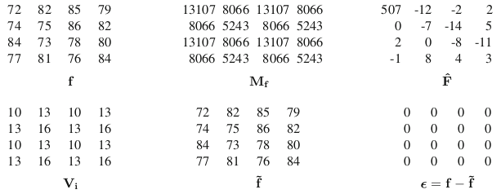
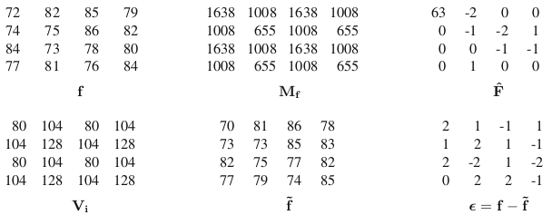
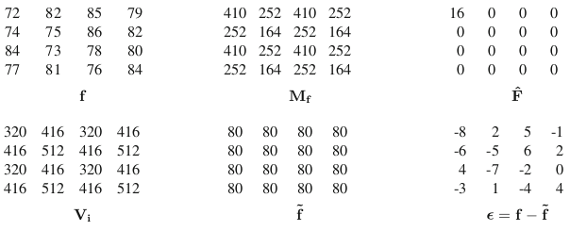
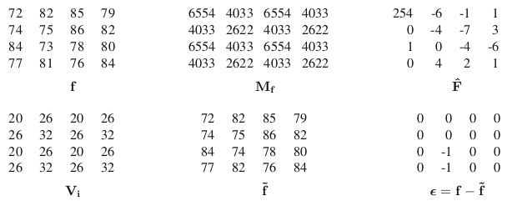
Examples of H.264 integer transform and quantization with various QPs
QP=0
QP=18
QP=30
QP=6
B C Dhara, Dept. of IT, JU

Slide 48
Intra coding
H.264 exploits much more spatial prediction than in previous video standards,
  Intra-coded macroblocks are predicted using some of the neighboring reconstructed pixels (using either intra- or inter-coded reconstructed pixels)
B C Dhara, Dept. of IT, JU

Slide 49
Intra-prediction
For luma sample
  4 x 4 block
    9 prediction modes
  16x16 block
    4 modes

Slide 50
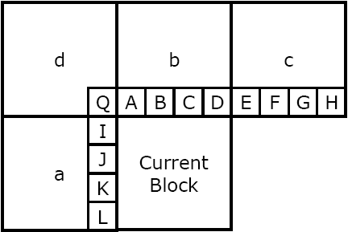
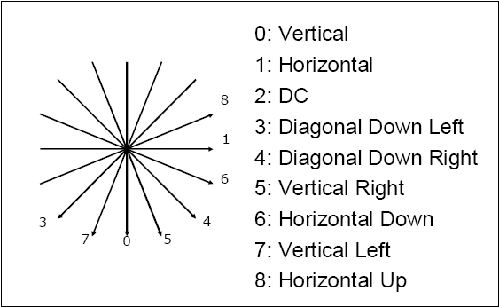
4x4 luma intra prediction
Prediction directions
Reference samples of 4x4 luma prediction

Slide 51
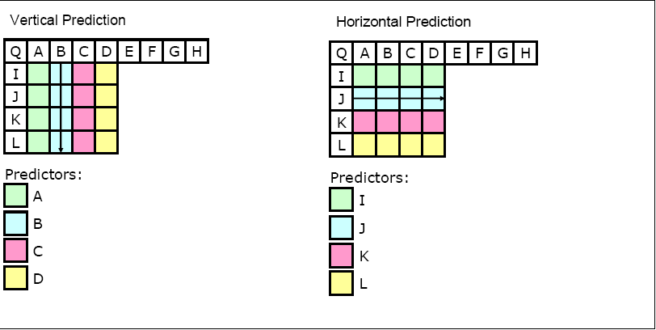
4x4 luma intra prediction

Slide 52
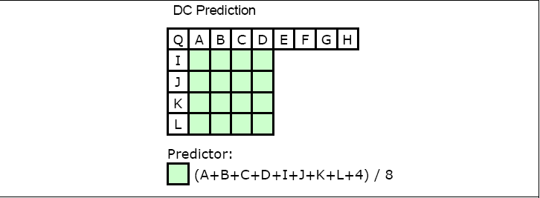
4x4 luma intra prediction

Slide 53
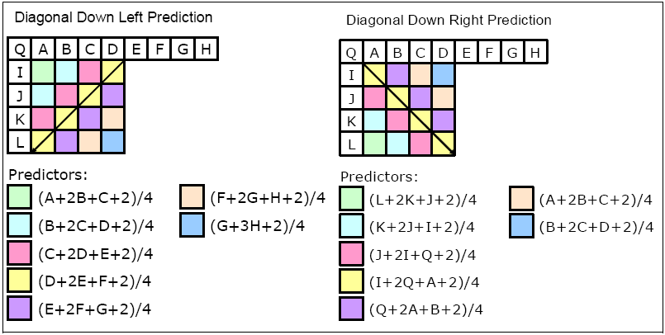
4x4 luma intra prediction

Slide 54
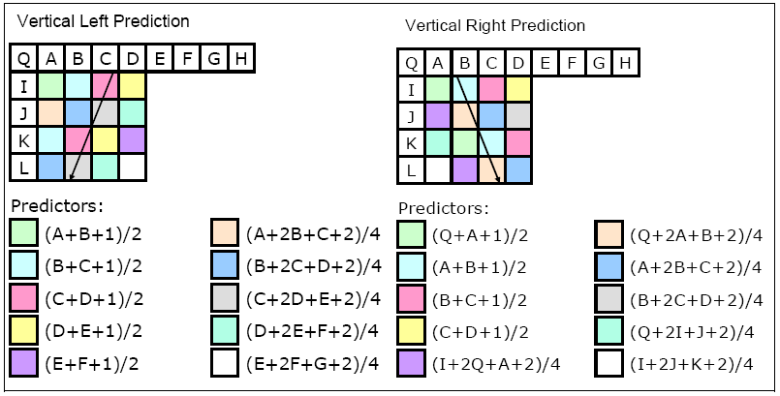
4x4 luma intra prediction

Slide 55
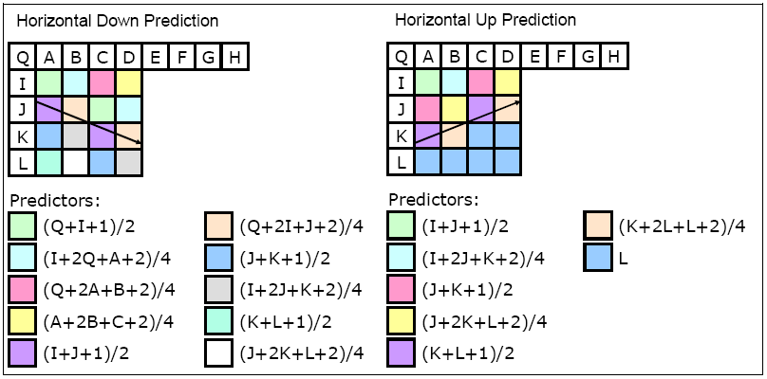
4x4 luma intra prediction

Slide 56
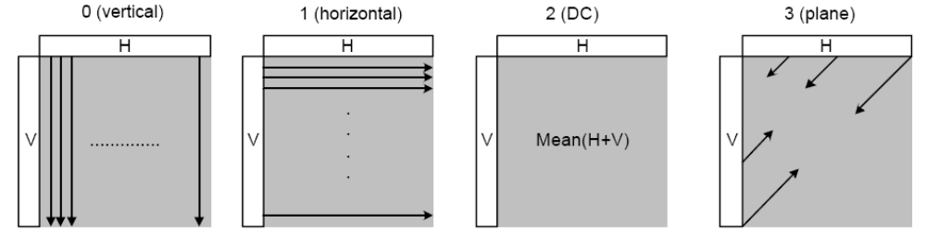
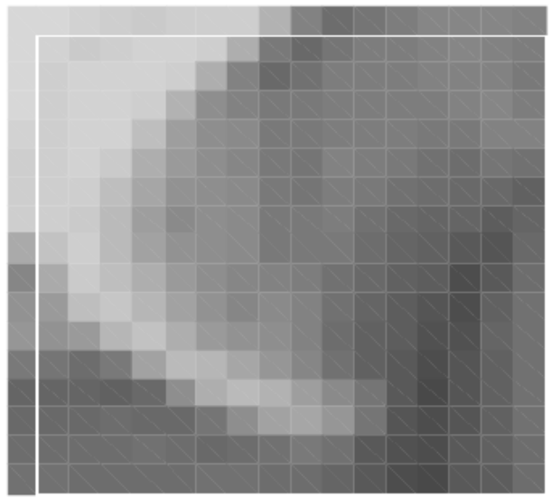
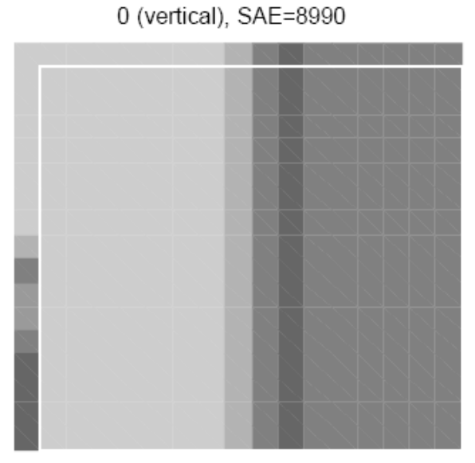
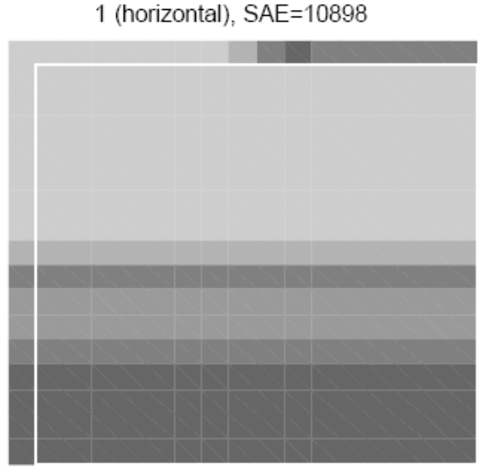
16x16 luma prediction modes
Org. block

Slide 57
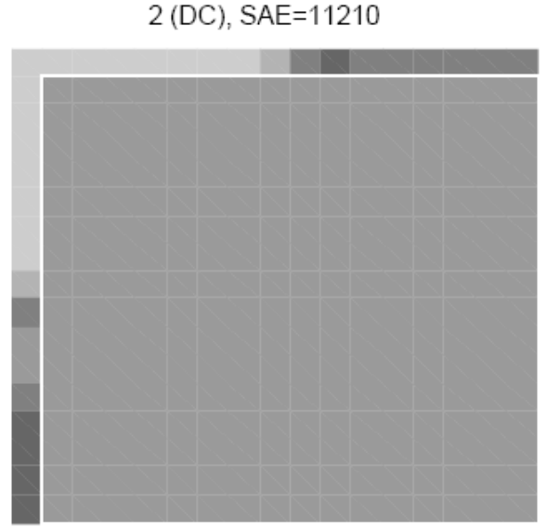
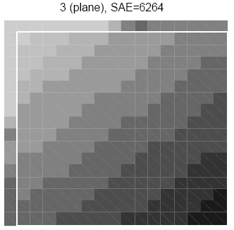
16x16 luma prediction modes
Org. block

Slide 58
8x8 chroma prediction
4 prediction modes similar to 16x16 luma prediction (except the mode number)
Both chroma blocks are predicted using same mode
If any of the 8x8 blocks in luma is coded in intra mode
  Both chroma blocks are intra coded

Slide 59
In-Loop Deblocking Filtering
One of the prominent deficiencies of the block based coding methods is the generation of unwanted visible block structures
  Pixels at the block boundaries are usually reconstructed less accurately: they tend to look like the interior pixels in the same block, hence the artificial appearance of blocks
  This is known as blocking artefacts
For better and smoothened appearance we need de-blocking filter
B C Dhara, Dept. of IT, JU

Slide 60
De-blocking filter
Applied after inverse transform in both encoder and decoder
Advantages:
  Block edges are smoothed, improving the appearance of decoded images
  The filtered macroblock is used for motion compensation prediction of future frames in encoder
    Resulting a smaller residual after prediction

Slide 61

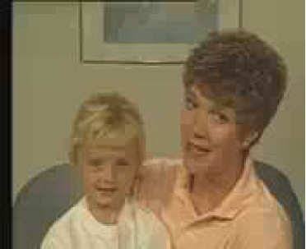


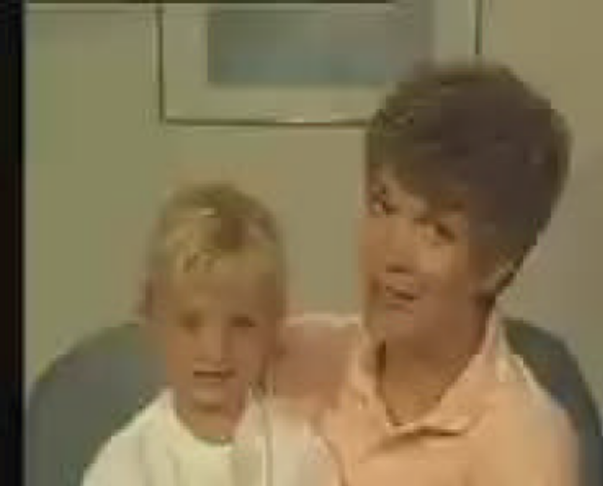
Filtering example
Original image
Reconstructed, QP =32, no filter
Reconstructed, QP =32, with filter
Reconstructed, QP =36, no filter
Reconstructed, QP =36, with filter

Slide 62
Entropy coding
When entropy_coding_mode is 0
  Residual quantized data is coded using Context Adaptive Variable Length Coding (CAVLC)
  Other units are coded using Exp-Golomb (exponential Golomb) coding
When entropy_coding_mode is 1
  Context-based Adaptive Binary Arithmetic Coding (CABAC) scheme is used

Slide 63
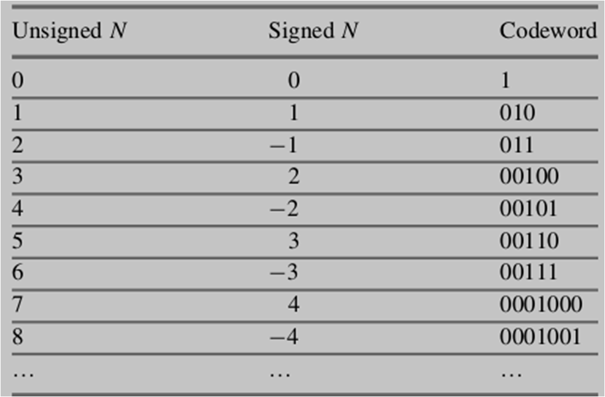
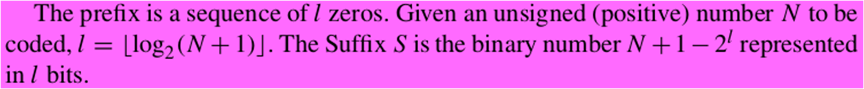
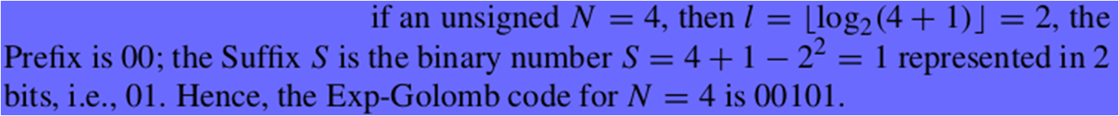
Simple Exp-Golomb code
The simple Exponential-Golomb (Exp-Golomb) code that is used for header data, etc., is the so-called 0th order Exp-Golomb code (EG₀)
  It is a binary code, and it consists of three parts: [Prefix] [1] [Suffix]
The 0th order Exp-Golomb codewords (EG₀)
B C Dhara, Dept. of IT, JU

Slide 64
Steps of CAVLC
It is known that the matrices (by default 4×4) that contain the quantized frequency coefficients of the residual data are typically sparse, i.e., contain many zeros
Even when they are nonzero, the quantized coefficients for higher frequencies are often +1 or −1 (the so-called “trailing_1s”)
CAVLC exploits these characteristics by carefully extracting the parameters from the current block data
B C Dhara, Dept. of IT, JU

Slide 65
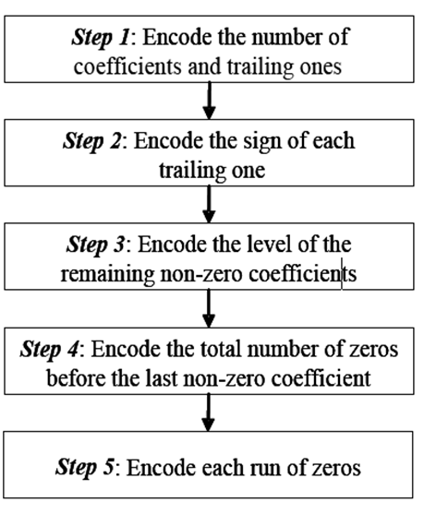

Steps of CAVLC
B C Dhara, Dept. of IT, JU

Slide 66
Context-based Adaptive Binary Arithmetic Coding (CABAC)
CABAC achieves good compression performance through
  Selecting probability model for each syntax element according to the element’s context
  Adapting probability estimates based on local statistics
  Using arithmetic coding

Slide 67

Block diagram of CABAC in H.264
B C Dhara, Dept. of IT, JU

Slide 68
CABAC coding
Binarization: CABAC uses binary arithmetic coding
  A non-binary symbol is converted into a binary code prior to arithmetic coding
Five schemes can be used for the binarization
  (a) Unary (U)—for N ≥ 0, it is N 1s followed by a terminating 0. For example, it is 111110 for 5
  (b)Truncated Unary (TU)—similar to U, but without the terminating 0
  (c) k^{th} order Exp-Golomb code
  (d)The concatenation of (a) and (c)
  (e) Fixed-Length binary scheme.

Slide 69
Context model selection: a context model is a probability model for one or more bins
  This model may be chosen from available models (267 model) depending on the statistics of the recently-coded data symbols
B C Dhara, Dept. of IT, JU

Slide 70
CABAC Coding (contd…)
Arithmetic coding
  Each bin is encoded according to the selected probability model
Probability update: the selected context model is updated based on the actual coded value
  e.g., if bin value was 1, the frequency count of ‘1’ is increased

